Slide 1
Anomaly and sequential detection with time series data
XuanLong Nguyen
xuanlong@eecs.berkeley.edu
CS 294 Practical Machine Learning Lecture
10/30/2006

Slide 2
Outline
Part I: Anomaly detection in time series
  unifying framework for anomaly detection methods
  applying techniques you have already learned so far in the class
    clustering, pca, dimensionality reduction
    classification
    probabilistic graphical models (HMM,..)
    hypothesis testing
Part 2: Sequential analysis (detecting the trend, not the burst)
  framework for reducing the detection delay time
  intro to problems and techniques
    sequential hypothesis testing
    sequential change-point detection

Slide 3
Anomalies in time series data
Time series is a sequence of data points, measured typically at successive times, spaced at (often uniform) time intervals
Anomalies in time series data are data points that significantly deviate from the normal pattern of the data sequence

Slide 4
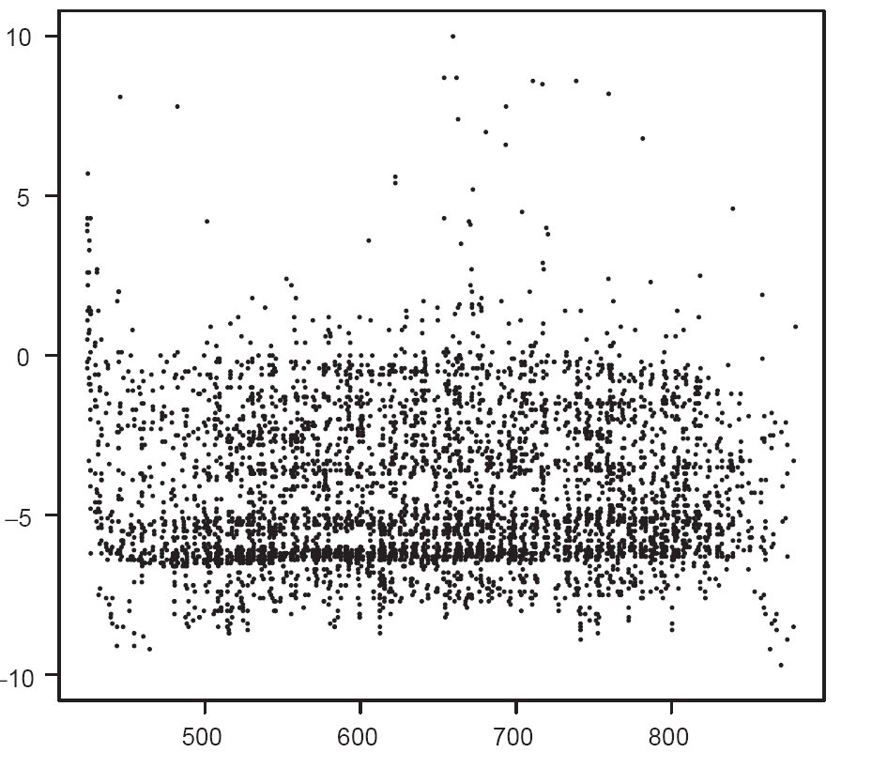
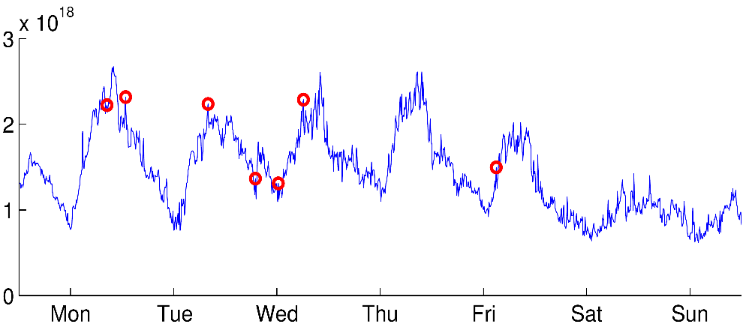
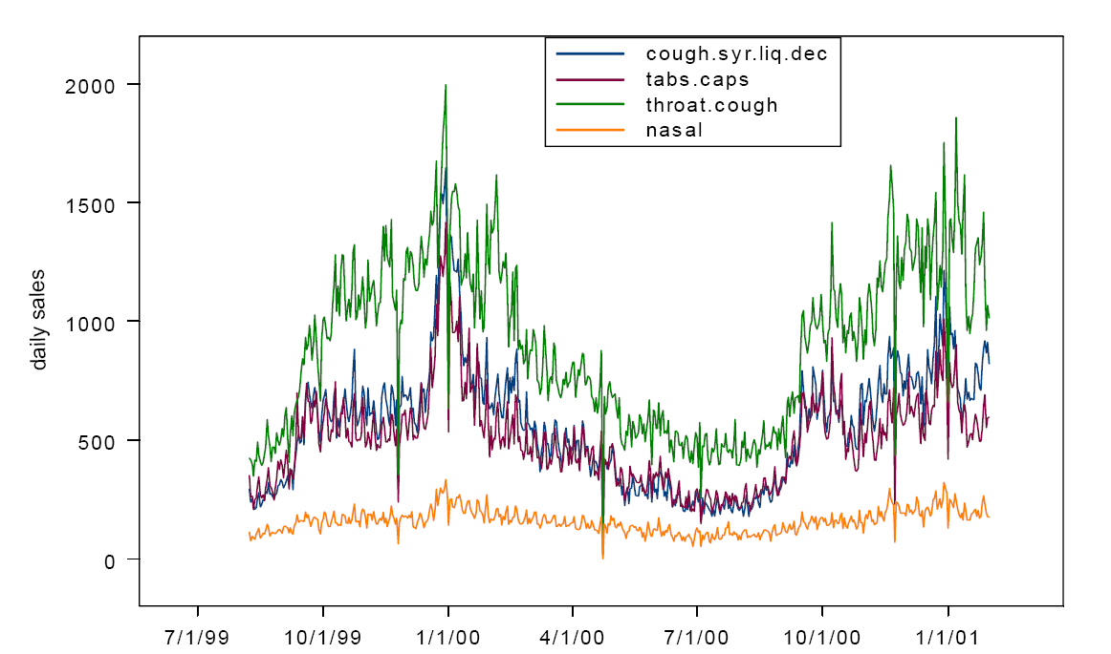

Examples of time series data
Telephone usage data
Network traffic data
Inhalational disease related data
6:12pm 10/30/2099
Matrix code

Slide 5

Anomaly detection
Potentially
fradulent
activities
Telephone usage data
Network traffic data
6:11 10/30/2099
Matrix code

Slide 6
Applications
Failure detection
Fraud detection (credit card, telephone)
Spam detection
Biosurveillance
  detecting geographic hotspots
Computer intrusion detection
  detecting masqueraders

Slide 7
Time series
What is it about time series structure
  Stationarity (e.g., markov, exchangeability)
  Typical stochastic process assumptions
  (e.g., independent increment as in Poisson process)
  Mixtures of above
Typical statistics involved
  Transition probabilities
  Event counts
  Mean, variance, spectral density,…
  Generally likelihood ratio of some kind
We shall try to exploit some of these structures in anomaly detection tasks
Don’t worry if you don’t know all of these terminologies!

Slide 8
List of methods
clustering, dimensionality reduction
mixture models
Markov chain
HMMs
mixture of MC’s
Poisson processes

Slide 9
Anomaly detection outline
Conceptual framework
Issues unique to anomaly detection
  Feature engineering
  Criteria in anomaly detection
  Supervised vs unsupervised learning
Example: network anomaly detection using PCA
Intrusion detection
  Detecting anomalies in multiple time series
Example: detecting masqueraders in multi-user systems

Slide 10
Conceptual framework
Learn a model of normal behavior
  Using supervised or unsupervised method
Based on this model, construct a suspicion score
  function of observed data
    (e.g., likelihood ratio/ Bayes factor)
  captures the deviation of observed data from normal model
  raise flag if the score exceeds a threshold

Slide 11
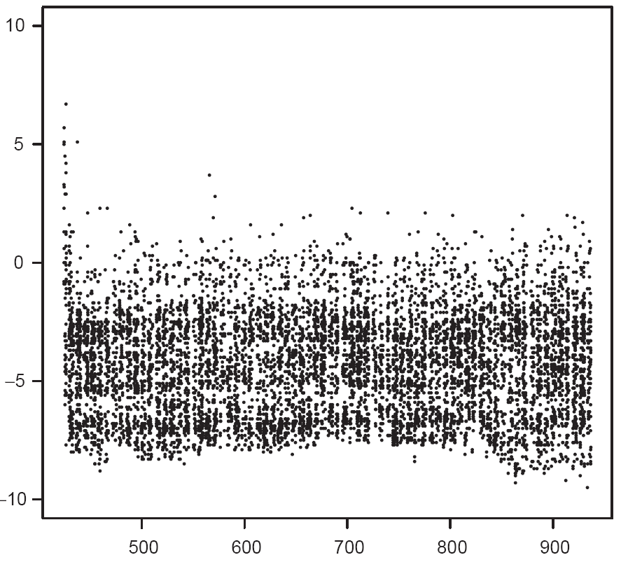
Example: Telephone traffic (AT&T)
[Scott, 2003]
Problem: Detecting if the phone usage of an account is abnormal or not
Data collection: phone call records and summaries of an account’s previous history
  Call duration, regions of the world called, calls to “hot” numbers, etc
Model learning: A learned profile for each account, as well as separate profiles of known intruders
Detection procedure:
  Cluster of high fraud scores between 650 and 720 (Account B)
Potentially
fradulent
activities
Account A
Account B
Fraud score
Time (days)

Slide 12
Criteria in anomaly detection
False alarm rate (type I error)
Misdetection rate (type II error)
Neyman-Pearson criteria
  minimize misdetection rate while false alarm rate is bounded
Bayesian criteria
  minimize a weighted sum for false alarm and misdetection rate
(Delayed) time to alarm
  second part of this lecture

Slide 13


Feature engineering
identifying features that reveal anomalies is difficult
features are actually evolving
  attackers constantly adapt to new tricks,
  user pattern also evolves in time

Slide 14
Feature choice by types of fraud
Example: Credit card/telephone fraud
  stolen card: unusual spending within short amount of time
  application fraud (using false information): first-time users, amount of spending
  unusual called locations
  “ghosting”: fraudster tricks the network to obtain free cards
Other domains: features might not be immediately indicative of normal/abnormal behavior

Slide 15
From features to models
More sophisticated test scores built upon aggregation of features
  Dimensionality reduction methods
    PCA, factor analysis, clustering
  Methods based on probabilistic
    Markov chain based, hidden markov models
    etc

Slide 16
Supervised vs unsupervised learning methods
Supervised methods (e.g.,classification):
  Uneven class size, different cost of different labels
  Labeled data scarce, uncertain
Unsupervised methods (e.g.,clustering, probabilistic models with latent variables such as HMM’s)

Slide 17
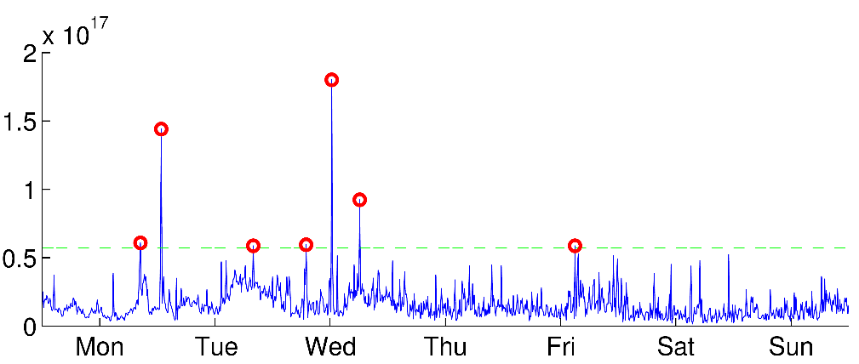
Example: Anomalies off the principal components
[Lakhina et al, 2004]
Abilene backbone network
traffic volume over 41 links
collected over 4 weeks
Perform PCA on 41-dim data
Select top 5 components
Network traffic data
anomalies
threshold
Projection to residual subspace

Slide 18
Anomaly detection outline
Conceptual framework
Issues unique to anomaly detection
Example: network anomaly detection using PCA
Intrusion detection
  Detecting anomalies in multiple time series
Example: detecting masqueraders in multi-user computer systems

Slide 19






















Intrusion detection
(multiple anomalies in multiple time series)

Slide 20
Broad spectrum of possibilities and difficulties
Trusted system users turning from legitimate usage to abuse of system resources
System penetration by sophisticated and careful hostile outsiders
One-time use by a co-worker “borrowing” a workstation
Automated penetrations by relatively naïve attacker via scripted attack sequences
Varying time spans from few seconds to months
Patterns might appear only in data gathered in distantly distributed sources
What sources? Command data, system call traces, network activity logs, CPU load averages, disk access patterns?
Data corrupted by noise or interspersed with examples of normal pattern usage

Slide 21
Intrusion detection
Each user has his own model (profile)
  Known attacker profiles
Updating: Models describing user behavior allowed to evolve (slowly)
  Reduce false alarm rate dramatically
  Recent data more valuable than old ones

Slide 22
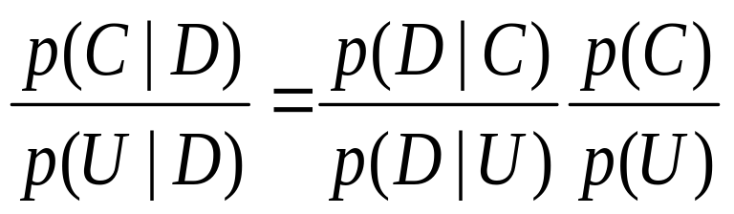
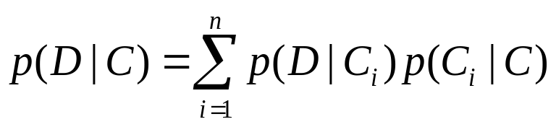
Framework for intrusion detection
D: observed data of an account
C: event that a criminal present, U: event account is controlled by user
P(D|U): model of normal behavior
P(D|C): model for attacker profiles
By Bayes’ rule
p(D|C)/p(D|U) is known as the Bayes factor for criminal activity
(or likelihood ratio)
Prior distribution p(C) key to control false alarm
A bank of n criminal profiles (C1,…,Cn)
  One of the Ci can be a vague model to guard against future attack

Slide 23
Simple metrics
Some existing intrusion detection procedures not formally expressed as probabilistic models
  one can often find stochastic models (under our framework) leading to the same detection procedures
Use of “distance metric” or statistic d(x) might correspond to
  Gaussian p(x|U) = exp(-d(x)^2/2)
  Laplace p(x|U) = exp(-d(x))
Procedures based on event counts may often be represented as multinomial models

Slide 24
Intrusion detection outline
Conceptual framework of intrusion detection procedure
Example: Detecting masqueraders
  Probabilistic models
  how models are used for detection

Slide 25
Markov chain based model for detecting masqueraders
[Ju & Vardi, 99]
Modeling “signature behavior” for individual users based on system command sequences
High-order Markov structure is used
  Takes into account last several commands instead of just the last one
  Mixture transition distribution
Hypothesis test using generalized likelihood ratio
Notes:
A markov chain model for profiling the UNIX command sequence of a computer user in order to identify a “signature behavior” for that user
High-order Markov structure is used
Takes into account last several commands instead of just the last one
But the number of parameters large (why?)
Restrict to a subset of most used commands, and remaining commands grouped to one signle command “other”
Mixture transition distribution

Slide 26
Data and experimental design
Data consist of sequences of (unix) system commands and user names
70 users, 150,000 consecutive commands each (=150 blocks of 100 commands)
Randomly select 50 users to form a “community”, 20 outsiders
First 50 blocks for training, next 100 blocks for testing
Starting after block 50, randomly insert command blocks from 20 outsiders
  For each command block i (i=50,51,...,150), there is a prob 1% that some masquerading blocks inserted after it
  The number x of command blocks inserted has geometric dist with mean 5
  Insert x blocks from an outside user, randomly chosen
Notes:
Data are collected from the output of the UNIX acct auditing mechanism
User names and the associated sequences of commands (without arguments) are used
Data contain about 70 users, for each there’re at least 15000 consecutive commands
Randomly select 50 users to form a “community”
Consider data for each as 150 blocks of 100 commands, first 50 blocks for training
Starting after block 50, some masquerading command blocks are randomly inserted to the command sequence, using command blocks from the other 20 users

Slide 27
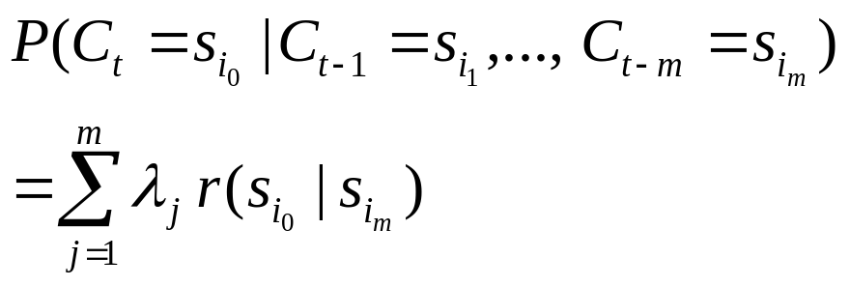
Markov chain profile for each user
sh
Consider the most frequently used command spaces
to reduce parameter space
K = 5
ls
cat
pine
others
Higher-order markov chain
m = 10
1% use
C1
C2
. . .
Cm
C
10 comds
Mixture transition distribution
Reduce number of paras from K^m
to K^2 + m (why?)

Slide 28
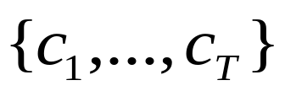
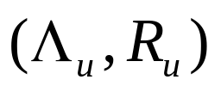
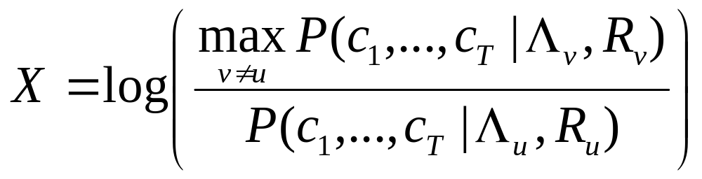
Testing against masqueraders
Given command sequence
Learn model (profile) for each user u
Test the hypothesis: H0 – commands generated by user u
H1 – commands NOT generated by user u
Test statistic (generalized likelihood ratio):
Raise flag whenever
X > some threshold w

Slide 29
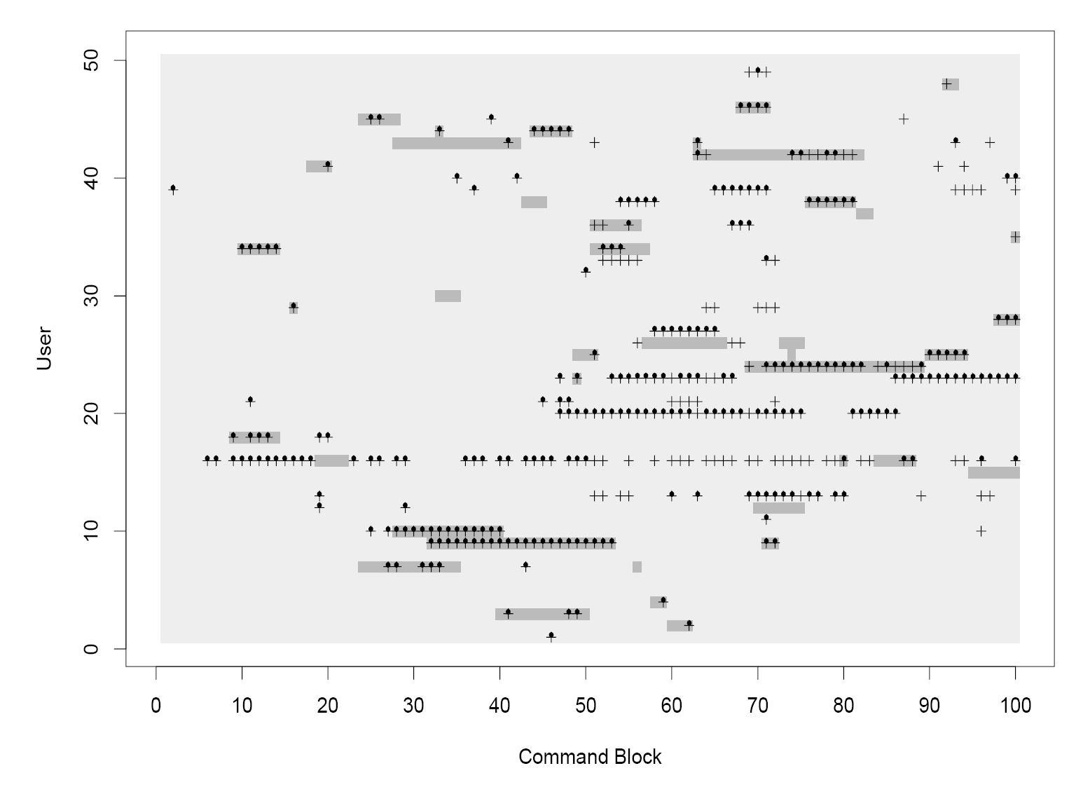
with updating (163 false alarms, 115 missed alarms, 93.5% accuracy)
+ without updating (221 false alarms, 103 missed alarms, 94.4% accuracy)
Masquerader blocks
missed alarms
false alarms

Slide 30
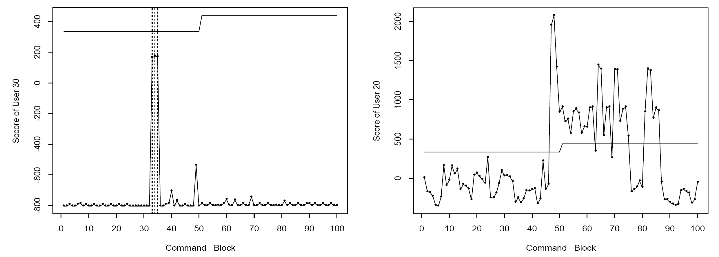
Results by users
Missed alarms
False alarms
threshold
Masquerader block
Test statistic

Slide 31
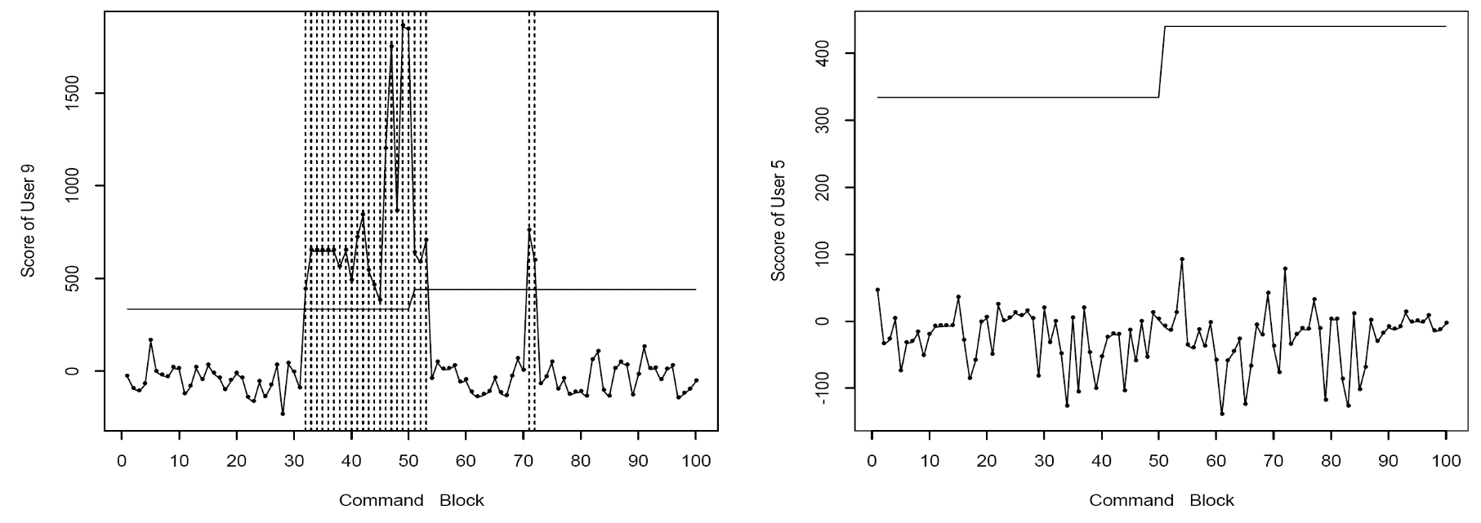
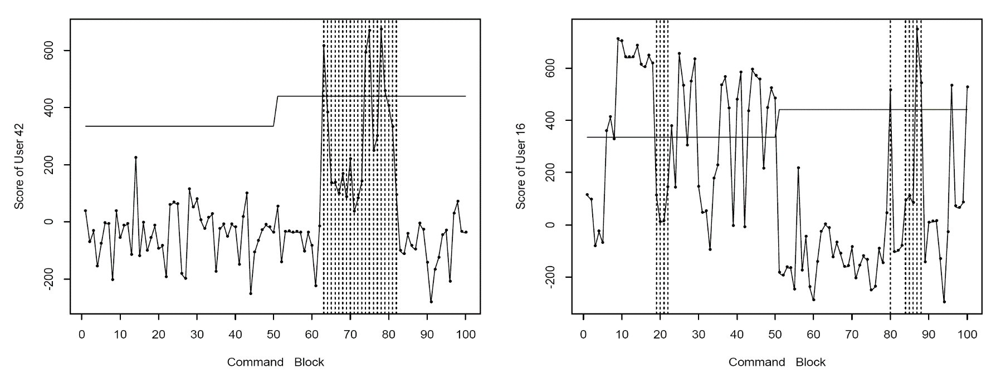
Results by users
Masquerader block
threshold
Test statistic

Slide 32
Take-home message (again)
Learn a model of normal behavior for each monitored individuals
Based on this model, construct a suspicion score
  function of observed data
    (e.g., likelihood ratio/ Bayes factor)
  captures the deviation of observed data from normal model
  raise flag if the score exceeds a threshold

Slide 33
Other models in literature
Simple metrics
  Hamming metric [Hofmeyr, Somayaji & Forest]
  Sequence-match [Lane and Brodley]
  IPAM (incremental probabilistic action modeling) [Davison and Hirsh]
  PCA on transitional probability matrix [DuMouchel and Schonlau]
More elaborate probabilistic models
  Bayes one-step Markov [DuMouchel]
  Compression model
  Mixture of Markov chains [Jha et al]
Elaborate probabilistic models can be used to obtain answer to more elaborate queries
  Beyond yes/no question (see next slide)

Slide 34
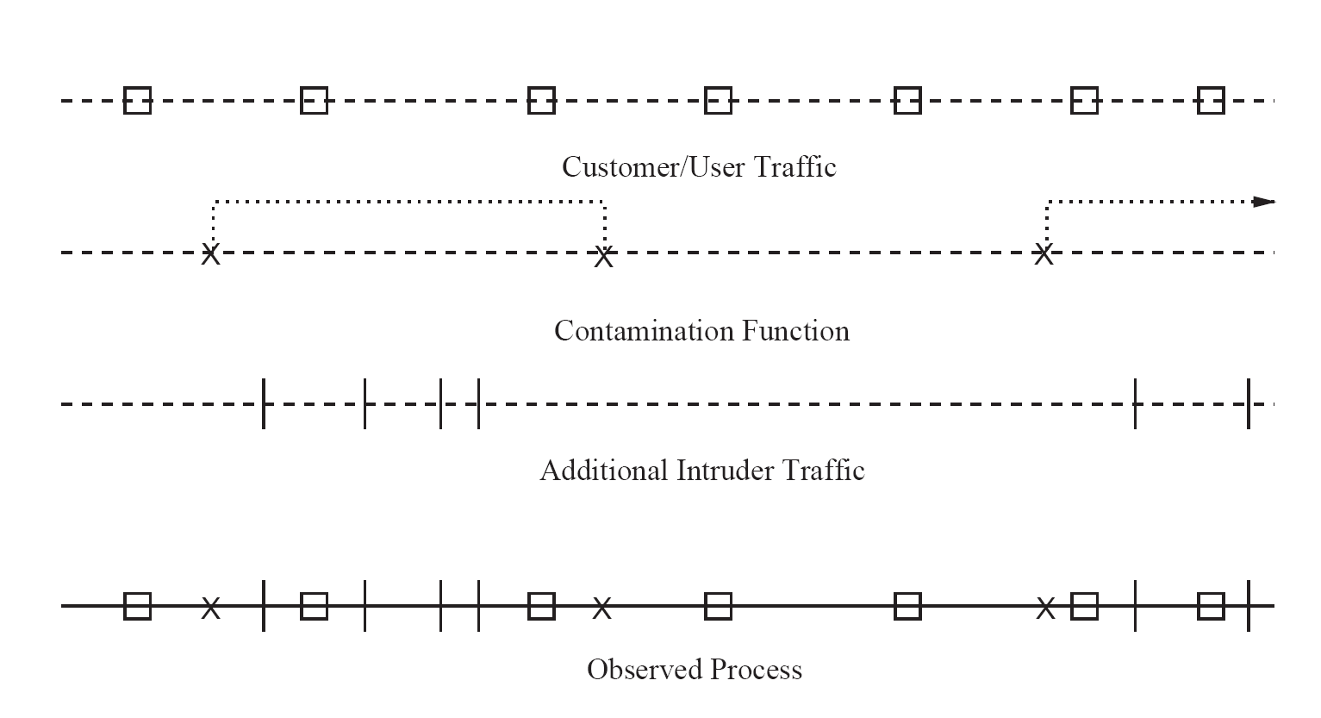
Burst modeling using Markov modulated Poisson process
[Scott, 2003]
Poisson process N0
binary Markov chain
Poisson process N1
can be also seen as a nonstationary discrete time HMM (thus all inferential machinary in HMM applies)
requires less parameter (less memory)
convenient to model sharing across time

Slide 35
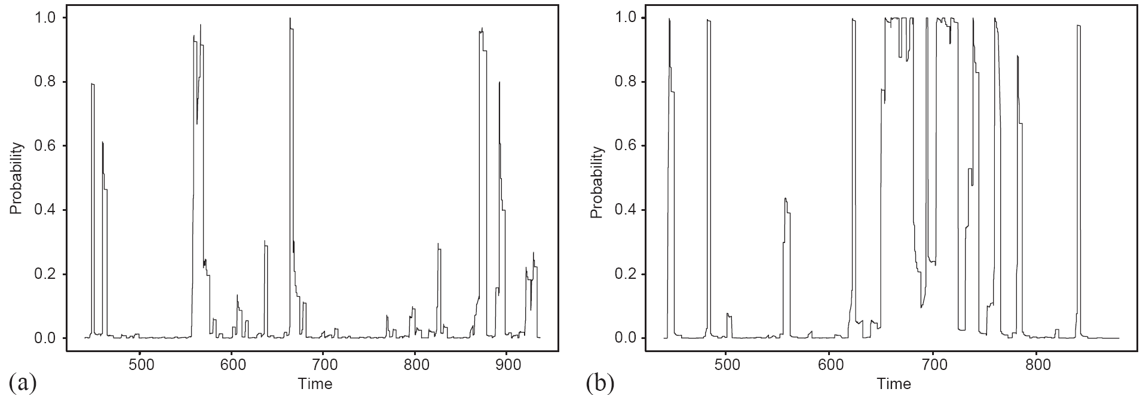
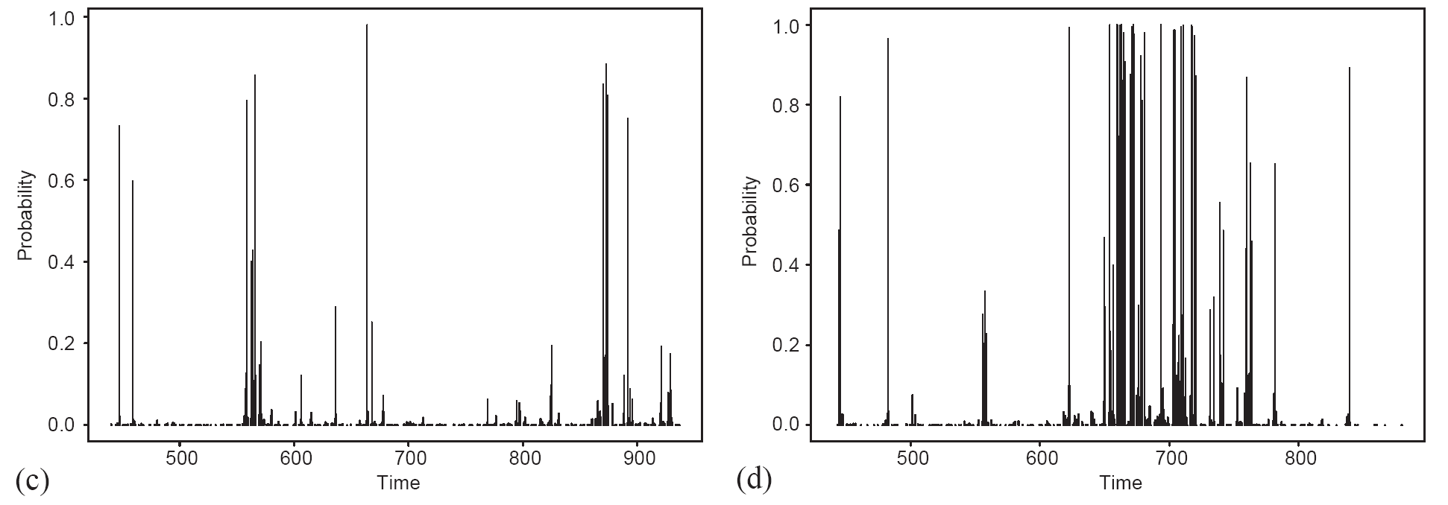
Detection results
Uncontaminated account
Contaminated account
probability of a
criminal presence
probability of each
phone call being
intruder traffic

Slide 36
Outline
Anomaly detection with time series data
Detecting bursts
Sequential detection with time series data
Detecting trends

Slide 37
Sequential analysis: balancing the tradeoff between detection accuracy and detection delay
XuanLong Nguyen
xuanlong@eecs.berkeley.edu
Radlab, 11/06/06

Slide 38
Outline
Motivation in detection problems
  need to minimize detection delay time
Brief intro to sequential analysis
  sequential hypothesis testing
  sequential change-point detection
Applications
  Detection of anomalies in network traffic (network attacks), faulty software, etc

Slide 39
Three quantities of interest in detection problems
Detection accuracy
  False alarm rate
  Misdetection rate
Detection delay time

Slide 40
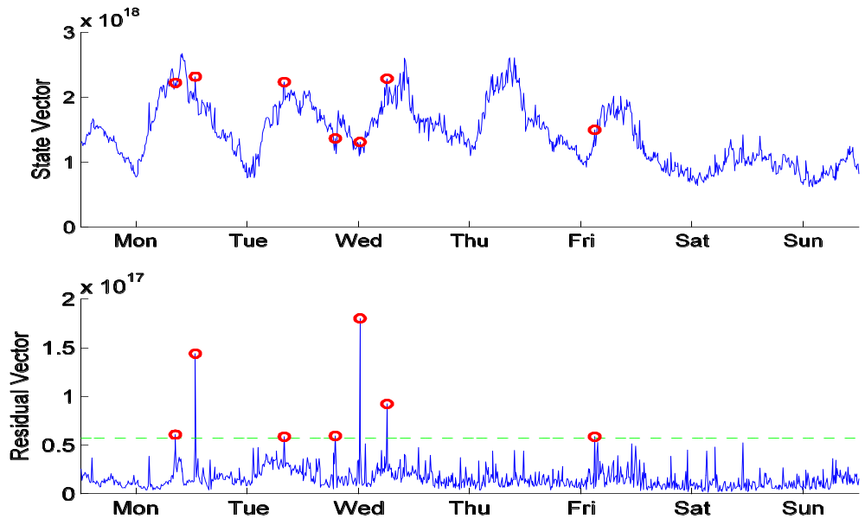
Network volume anomaly detection
[Huang et al, 06]

Slide 41
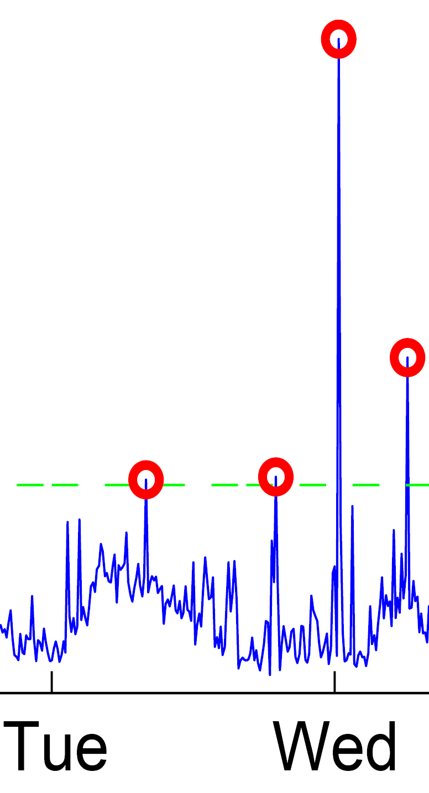
So far, anomalies treated as isolated events
Spikes seem to appear out of nowhere
Hard to predict early short burst
  unless we reduce the time granularity of collected data
To achieve early detection
  have to look at medium to long-term trend
  know when to stop deliberating

Slide 42
Early detection of anomalous trends
We want to
  distinguish “bad” process from good process/ multiple processes
  detect a point where a “good” process turns bad
Applicable when evidence accumulates over time (no matter how fast or slow)
  e.g., because a router or a server fails
  worm propagates its effect
Sequential analysis is well-suited
  minimize the detection time given fixed false alarm and misdetection rates
  balance the tradeoff between these three quantities (false alarm, misdetection rate, detection time) effectively

Slide 43
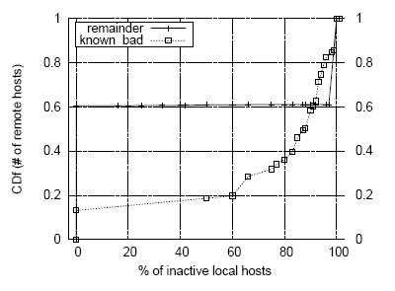
Example: Port scan detection
(Jung et al, 2004)
Detect whether a remote host is a port scanner or a benign host
Ground truth: based on percentage of local hosts which a remote host has a failed connection
We set:
  for a scanner, the probability of hitting inactive local host is 0.8
  for a benign host, that probability is 0.1
Figure:
  X: percentage of inactive local hosts for a remote host
  Y: cumulative distribution function for X
80% bad hosts

Slide 44
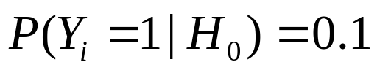
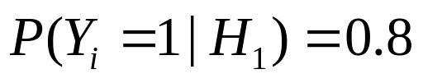
Hypothesis testing formulation
A remote host R attempts to connect a local host at time i
  let Yi = 0 if the connection attempt is a success,
  1 if failed connection
As outcomes Y1, Y2,… are observed we wish to determine whether R is a scanner or not
Two competing hypotheses:
  H0: R is benign
  H1: R is a scanner

Slide 45
An off-line approach
Collect sequence of data Y for one day
(wait for a day)
2. Compute the likelihood ratio accumulated over a day
  This is related to the proportion of inactive local hosts that R tries to connect (resulting in failed connections)
3. Raise a flag if this statistic exceeds some threshold

Slide 46
A sequential (on-line) solution
Update accumulative likelihood ratio statistic in an online fashion
2. Raise a flag if this exceeds some threshold
Acc. Likelihood ratio
Threshold a
Stopping time
Threshold b
0
24
hour

Slide 47
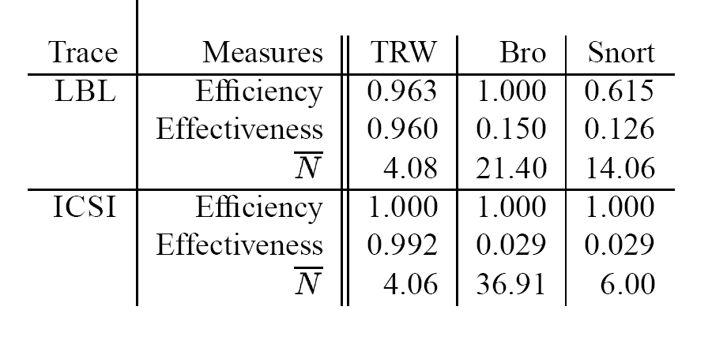
Comparison with other existing intrusion detection systems (Bro & Snort)
0.963
0.040
4.08
1.000
0.008
4.06
Efficiency: 1 - #false positives / #true positives
Effectiveness: #false negatives/ #all samples
N: # of samples used (i.e., detection delay time)

Slide 48
Two sequential decision problems
Sequential hypothesis testing
  differentiating “bad” process from “good process”
  E.g., our previous portscan example
Sequential change-point detection
  detecting a point(s) where a “good” process starts to turn bad

Slide 49
Sequential hypothesis testing
H = 0 (Null hypothesis):
normal situation
H = 1 (Alternative hypothesis): abnormal situation
Sequence of observed data
  X1, X2, X3, …
Decision consists of
  stopping time N (when to stop taking samples?)
  make a hypothesis
  H = 0 or H = 1 ?

Slide 50
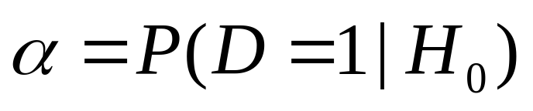
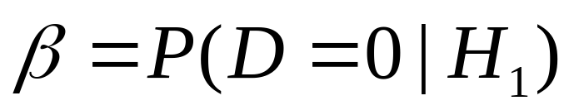
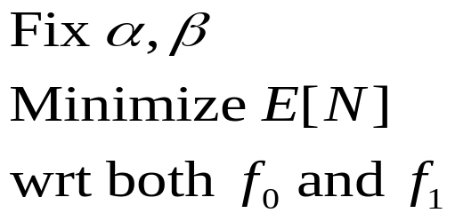
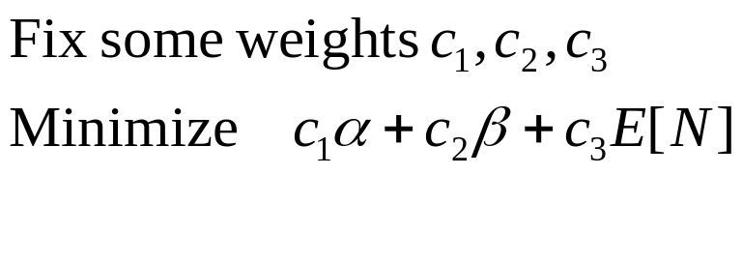
Quantities of interest
False alarm rate
Misdetection rate
Expected stopping time (aka number of samples, or decision delay time) E N
Frequentist formulation:
Bayesian formulation:

Slide 51



Key statistic: Posterior probability
As more data are observed, the posterior is edging closer to either 0 or 1
Optimal cost-to-go function is a function of
G(p) can be computed by Bellman’s update
  G(p) = min { cost if stop now,
  or cost of taking one more sample}
  G(p) is concave
Stop: when pn hits thresholds
  a or b
N(m0,v0)
N(m1,v1)
:= optimal G
G(p)
p1, p2,..,pn
0
a
b
1 p

Slide 52

Multiple hypothesis test
H=1
Suppose we have m hypotheses
H = 1,2,…,m
The relevant statistic is posterior probability vector in (m-1) simplex
Stop when pn reaches on of the corners (passing through red boundary)
H=2
H=3

Slide 53
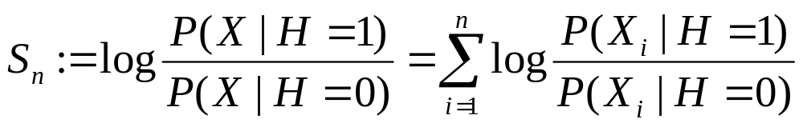
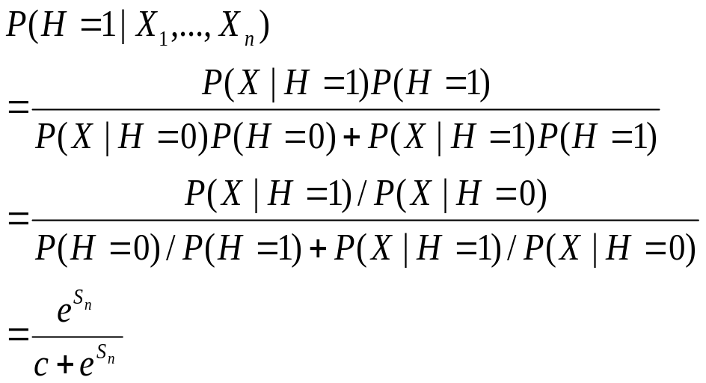
Thresholding posterior probability = thresholding sequential log likelihood ratio
Log likelihood ratio:
Applying Bayes’ rule:

Slide 54
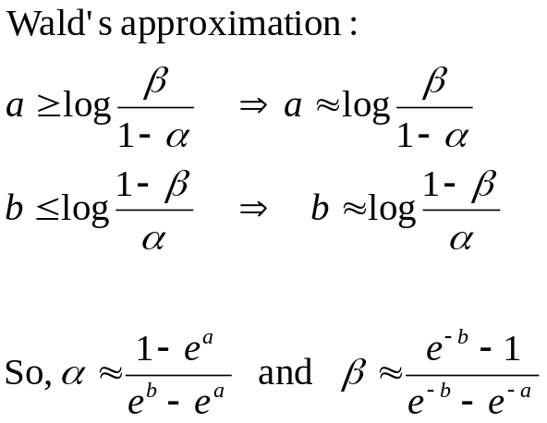
Thresholds vs. errors
Sn
Acc. Likelihood ratio
Threshold b
0
Stopping time (N)
Threshold a
Exact if there’s no overshoot
at hitting time!

Slide 55

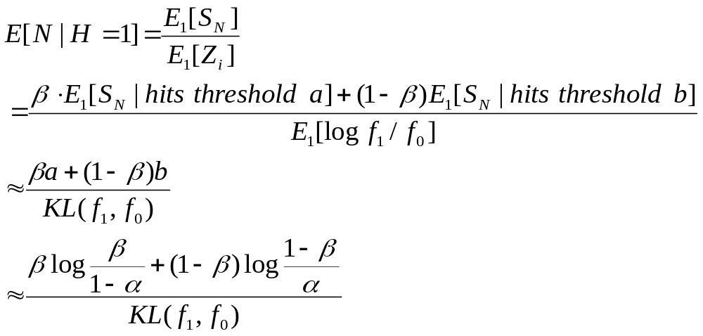
Expected stopping times vs errors
The stopping time of hitting time N of a random walk
What is E[N]?
Wald’s equation

Slide 56
Outline
Sequential hypothesis testing
Change-point detection
  Off-line formulation
    methods based on clustering /maximum likelihood
  On-line (sequential) formulation
    Minimax method
    Bayesian method
  Application in detecting network traffic anomalies

Slide 57
Change-point detection problem
Xt
t1
t2
Identify where there is a change in the data sequence
  change in mean, dispersion, correlation function, spectral density, etc…
  generally change in distribution

Slide 58
Off-line change-point detection
Viewed as a clustering problem across time axis
  Change points being the boundary of clusters
Partition time series data that respects
  Homogeneity within a partition
  Heterogeneity between partitions

Slide 59
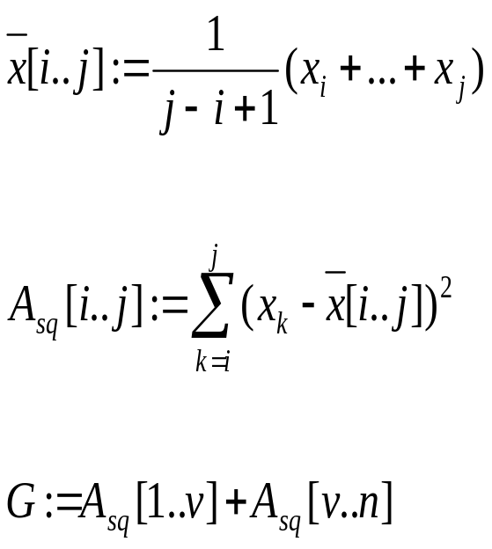
A heuristic: clustering by minimizing intra-partition variance
Suppose that we look at a mean changing process
Suppose also that there is only one change point
Define running mean x[i..j]
Define variation within a partition Asq[i..j]
Seek a time point v that minimizes the sum of variations G
(Fisher, 1958)

Slide 60
Statistical inference of change point
A change point is considered as a latent variable
Statistical inference of change point location via
  frequentist method, e.g., maximum likelihood estimation
  Bayesian method by inferring posterior probability

Slide 61
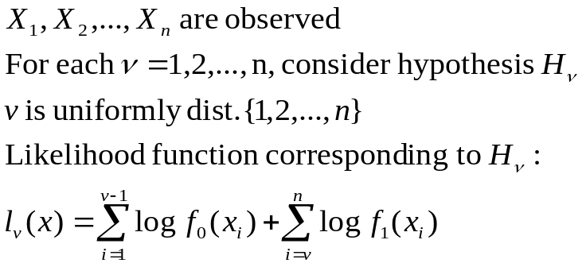

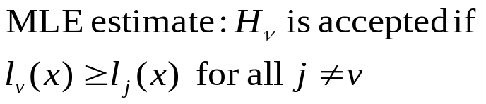
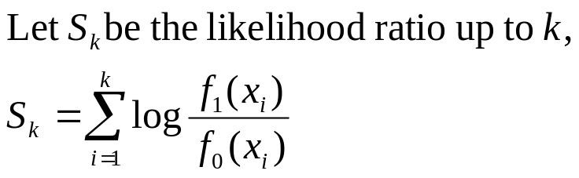
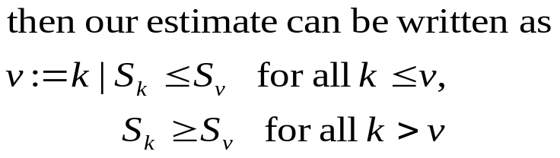
Maximum-likelihood method
[Page, 1965]
Hypothesis Hv: sequence has
density f0 before v, and f1 after
Hypothesis H0: sequence is
stochastically homogeneous
This is the precursor for various
sequential procedures (to come!)
f1
Sk
f0
1
v
n
k

Slide 62
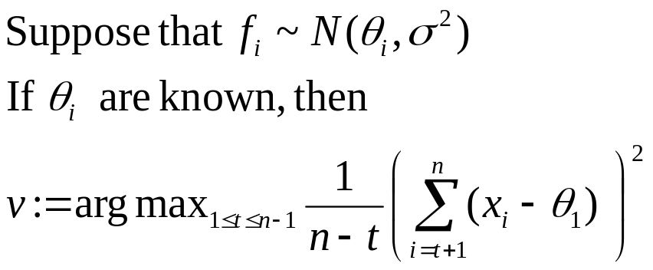
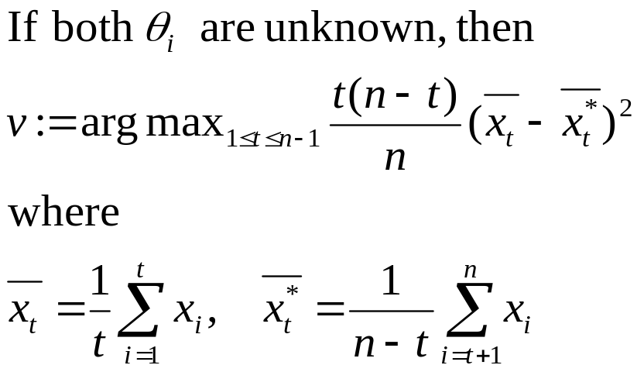
Maximum-likelihood method
[Hinkley, 1970,1971]

Slide 63
Sequential change-point detection
f0
f1
Data are observed serially
There is a change from distribution f0 to f1 in at time point v
Raise an alarm if change is detected at N
Delayed alarm
False alarm
time
N
Change point v
Need to
(a) Minimize the false alarm rate
(b) Minimize the average delay to detection

Slide 64
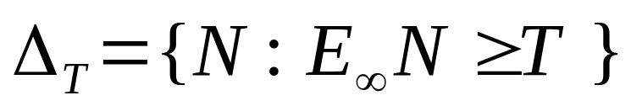
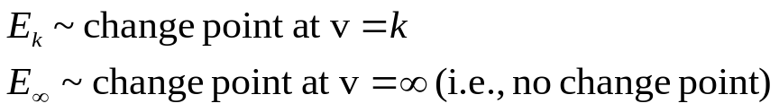

Minimax formulation
Among all procedures such that the time to false alarm is
bounded from below by a constant T, find a procedure that
minimizes the average delay to detection
Class of procedures with false alarm condition
Cusum,
SRP tests
Average delay to detection
Cusum test
average-worst delay
worst-worst delay

Slide 65

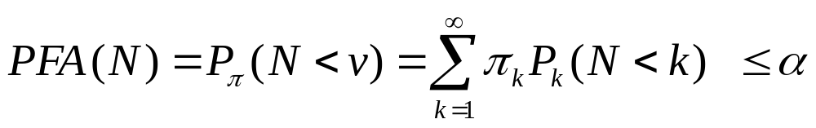

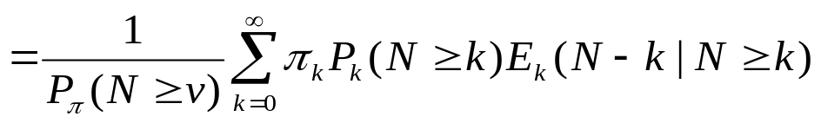
Bayesian formulation
Assume a prior distribution of the change point
Among all procedures such that the false alarm probability is
less than \alpha, find a procedure that minimizes the average
delay to detection
False alarm condition
Average delay to detecion
Shiryaev’s test

Slide 66
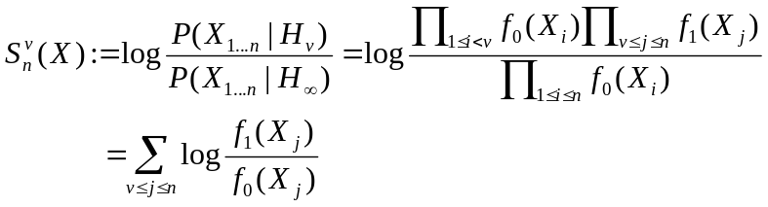


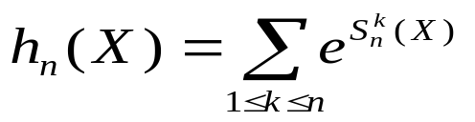
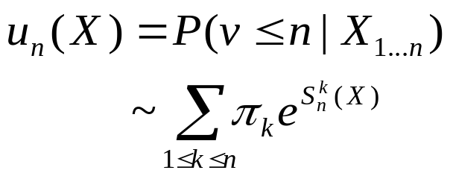
All procedures involve running likelihood ratios
Likelihood ratio for v = k vs. v = infinity
Hypothesis Hv: sequence has
density f0 before v, and f1 after
Hypothesis : no change point
All procedures involve online thresholding:
Stop whenever the statistic exceeds a threshold b
Cusum test :
Shiryaev-Roberts-Polak’s:
Shiryaev’s Bayesian test:

Slide 67
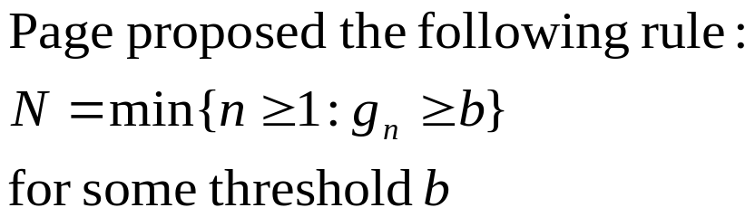
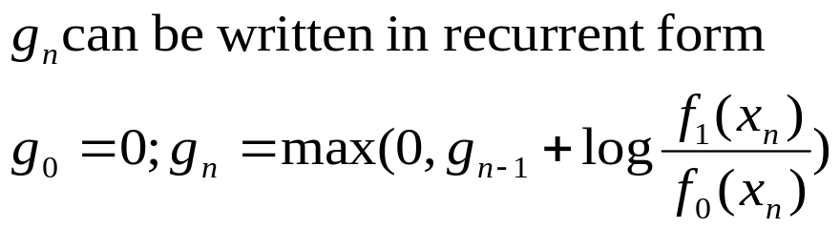

Cusum test (Page, 1966)
gn
b
Stopping time N
This test minimizes the worst-average detection delay (in an asymptotic sense):

Slide 68


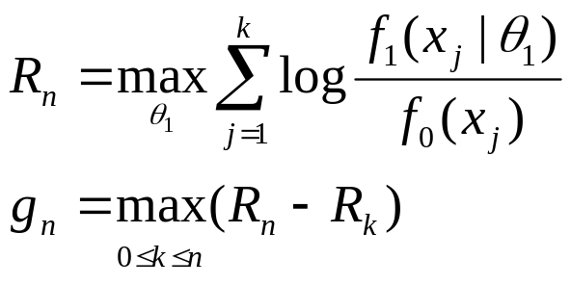
Generalized likelihood ratio
Unfortunately, we don’t know f0 and f1
Assume that they follow the form
f0 is estimated from “normal” training data
f1 is estimated on the flight (on test data)
Sequential generalized likelihood ratio statistic (same as CUSUM):
Our testing rule: Stop and declare the change point
at the first n such that
gn exceeds a threshold b

Slide 69
Change point detection in network traffic
[Hajji, 2005]
N(m0,v0)
N(m1,v1)
N(m,v)
Data features:
number of good packets received that were directed to the
broadcast address
number of Ethernet packets with an unknown protocol type
number of good address resolution protocol (ARP) packets
on the segment
number of incoming TCP connection requests (TCP packets
with SYN flag set)
Changed behavior
Each feature is modeled as a mixture of 3-4 gaussians
to adjust to the daily traffic patterns (night hours vs day times,
weekday vs. weekends,…)

Slide 70
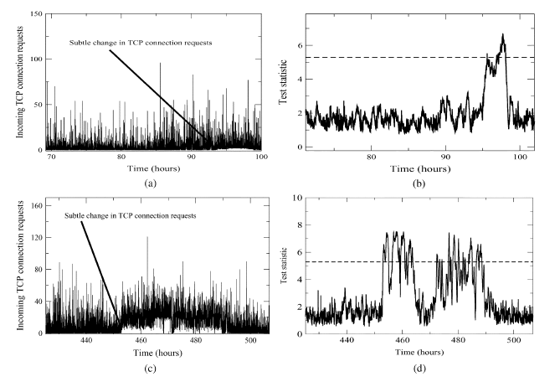
Subtle change in traffic
(aggregated statistic vs individual variables)
Caused by web robots

Slide 71

Adaptability to normal daily and weekely fluctuations
weekend
PM time

Slide 72


Anomalies detected
Broadcast storms, DoS attacks
injected 2 broadcast/sec
16mins delay
Sustained rate of TCP connection requests
injecting 10 packets/sec
17mins delay

Slide 73


Anomalies detected
ARP cache poisoning attacks
16mins delay
TCP SYN DoS attack, excessive
traffic load
50 seconds delay

Slide 74
Summary
Sequential hypothesis test
  distinguish “good” process from “bad”
Sequential change-point detection
  detecting where a process changes its behavior
Framework for optimal reduction of detection delay
Sequential tests are very easy to apply
  even though the analysis might look difficult

Slide 75
References for anomaly detection
Schonlau, M, DuMouchel W, Ju W, Karr, A, theus, M and Vardi, Y. Computer instrusion: Detecting masquerades, Statistical Science, 2001.
Jha S, Kruger L, Kurtz, T, Lee, Y and Smith A. A filtering approach to anomaly and masquerade detection. Technical report, Univ of Wisconsin, Madison.
Scott, S., A Bayesian paradigm for designing intrusion detection systems. Computational Statistics and Data Analysis, 2003.
Bolton R. and Hand, D. Statistical fraud detection: A review. Statistical Science, Vol 17, No 3, 2002,
Ju, W and Vardi Y. A hybrid high-order Markov chain model for computer intrusion detection. Tech Report 92, National Institute Statistical Sciences, 1999.
Lane, T and Brodley, C. E. Approaches to online learning and concept drift for user identification in computer security. Proc. KDD, 1998.
Lakhina A, Crovella, M and Diot, C. diagnosing network-wide traffic anomalies. ACM Sigcomm, 2004

Slide 76
References for sequential analysis
Wald, A. Sequential analysis, John Wiley and Sons, Inc, 1947.
Arrow, K., Blackwell, D., Girshik, Ann. Math. Stat., 1949.
Shiryaev, R. Optimal stopping rules, Springer-Verlag, 1978.
Siegmund, D. Sequential analysis, Springer-Verlag, 1985.
Brodsky, B. E. and Darkhovsky B.S. Nonparametric methods in change-point problems. Kluwer Academic Pub, 1993.
Baum, C. W. & Veeravalli, V.V. A Sequential Procedure for Multihypothesis Testing. IEEE Trans on Info Thy, 40(6)1994-2007, 1994.
Lai, T.L., Sequential analysis: Some classical problems and new challenges (with discussion), Statistica Sinica, 11:303—408, 2001.
Mei, Y. Asymptotically optimal methods for sequential change-point detection, Caltech PhD thesis, 2003.
Hajji, H. Statistical analysis of network traffic for adaptive faults detection, IEEE Trans Neural Networks, 2005.
Tartakovsky, A & Veeravalli, V.V. General asymptotic Bayesian theory of quickest change detection. Theory of Probability and Its Applications, 2005
Nguyen, X., Wainwright, M. & Jordan, M.I. On optimal quantization rules in sequential decision problems. Proc. ISIT, Seattle, 2006.

